Slide 1

Chapter 12
Summary and Outlook
Notes:
This chapter reflects on the current state of the art of agent-based models and factors that may shape the future of this discipline. Specifically we will discuss the key challenges for developing robust agent-based models of geographical systems as well as potential solutions. We argue that we need to make progress on these challenges if these models are to be used to offer insight into key societal challenges, for example climate change, urban growth and migration.

Slide 2
Learning Objectives
By the end of this lecture, students will be able to:
Discuss the key challenges for developing robust agent-based models of geographical systems
Have ideas on potential solutions for overcoming such challenges
Be able to identify areas for productive future research in the fields of agent-based modeling and GIS.

Slide 3
Introduction
Agent-based models can be used to study geographical systems,
Throughout this course we have demonstrated how geographical information can be used as the grounding of our ‘artificial worlds’.
We have explored issues pertaining to:
How to design and development of agent-based models;
Incorporate human behavior into agent-based models;
Outlined methods for understanding and evaluating;
Compared and contrasted agent-based models to other modeling approaches.
But what challenges remain?

Slide 4
Remaining Challenges
The challenges include:
Reasons for Modelling
Theory and Models
Inter-Model Comparison
Replication and Experiment
Verification and Validation
Agent Representation, Aggregation and Dynamics
Behavior
Sharing and Dissemination of the Model
Data Challenges

Slide 5
Challenge 1: Reasons for Modelling
In the early days of computer modelling, models were built to test the impacts of policies rather than scientific understanding per se.
Agent-based models are now built to explore all stages of the theory–practice continuum (not just for prediction).
However, agent-based models are only useful for the purpose for which it was constructed, and as modelers we need to be explicit about this.

Slide 6
Challenge 2: Theory and Models
The goal of theory is to make the world understandable by finding the right level of abstraction (or simplification).
Traditionally in the social sciences, the role of a model was to translate a theory into a form whereby it could be tested, manipulated and refined.
But which theory to test?
Does the theory have enough details to be agentized?
With agent-based models (along with computational modelling more generally) models are often being used to develop theory.
If this is the case we need to be explicit about the assumptions.

Slide 7
Challenge 3: Inter-Model Comparison
Growing number of agent-based models.
Many are based on case studies, one-off models or as proof of concept.
Limited inter-model comparison such as is seen in other disciplines.
E.g., the Ice Sheet Model Intercomparison Project
Efforts are being made to compare different models applied to the same phenomena.
E.g. Ebola, Malaria,
Efforts also being made to common features of models exploring the same phenomena in order to find what constitutes the must have features
E.g. Slums
However, there are no centralized agent-based modelling repositories that pool together knowledge, code and data.
Nor is there any standard model or protocol on what constitutes an agent or its decision-making process.

Slide 8
Challenge 4: Replication and Experiment
Replication is one of the main principles of the scientific method
In the confines of a publication, this is hard to achieve with agent-based models.
Attempts are being made
ODD protocol, the ODD+D protocol and UML
Many modelers don’t share their models or data
Why?

Slide 9
Challenge 5: Verification & Validation (V & V)
While discussed earlier we list these here as V & V is needed for replication and experimentation
Validation is a big challenge.
How can we rigorously evaluate how well the model matches the real-world system it is attempting to simulate?
Agent-based models embrace heterogeneous systems that evolve over time, where the linkages between dependent and independent variables are difficult, if not impossible, to observe due to their rich model structure
Finding appropriately rich and detailed data to validate such systems is difficult.

Slide 10
Challenge 6: Agent Representation, Aggregation and Dynamics
Agents can be defined at a variety of levels (individuals, households, etc.) and can operate at very different temporal and spatial scales (e.g. from seconds to years).
But how should we we chose such representation or dynamics.
How should we aggregate these rules and behaviors from the individual level to, say, groups or higher aggregations of agents?
How many agents and how many attributes for each agent we should account for?
Modelers need to be more explicit with respect to:
Agent representations,
Why they chose a specific spatial and temporal scales,
What data exists to support their assumptions and validate their outcomes.

Slide 11
Challenge 7: Behavior
The role of theory and the representation of agents are both linked to the actions and behavior embedded within agents.
However, often modelers do not consider the use of alternative behavioral frameworks or describe in detail why one was chosen over another.
Many models take an ad hoc approach to implementing decisions without reference to appropriate theories or do a poor job of describing the decision making of their agents.
However, frameworks such as ODD+D and Modelling Human Behavior attempt to make overcome these challenges,
Efforts are also underway to develop cognitive frameworks within modelling packages (e.g. MATSims & GAMA) and to incorporate learning or memory within their decision-making process.

Slide 12
Challenge 8: Sharing and Dissemination of the Model
Gilbert et al. (2002) note:
“it is frequently the case that policy-makers dismiss academic research as too theoretical, unrelated to the actual problems they are wrestling with, or in other ways irrelevant to their concerns”
One way to circumnavigate this issue is to explore participatory modelling or companion modelling.
Another way of sharing and disseminating models is simply by taking advantage of the internet – not only in disseminating models but also by allowing users to access, run and explore models in their own browsers.

Slide 13
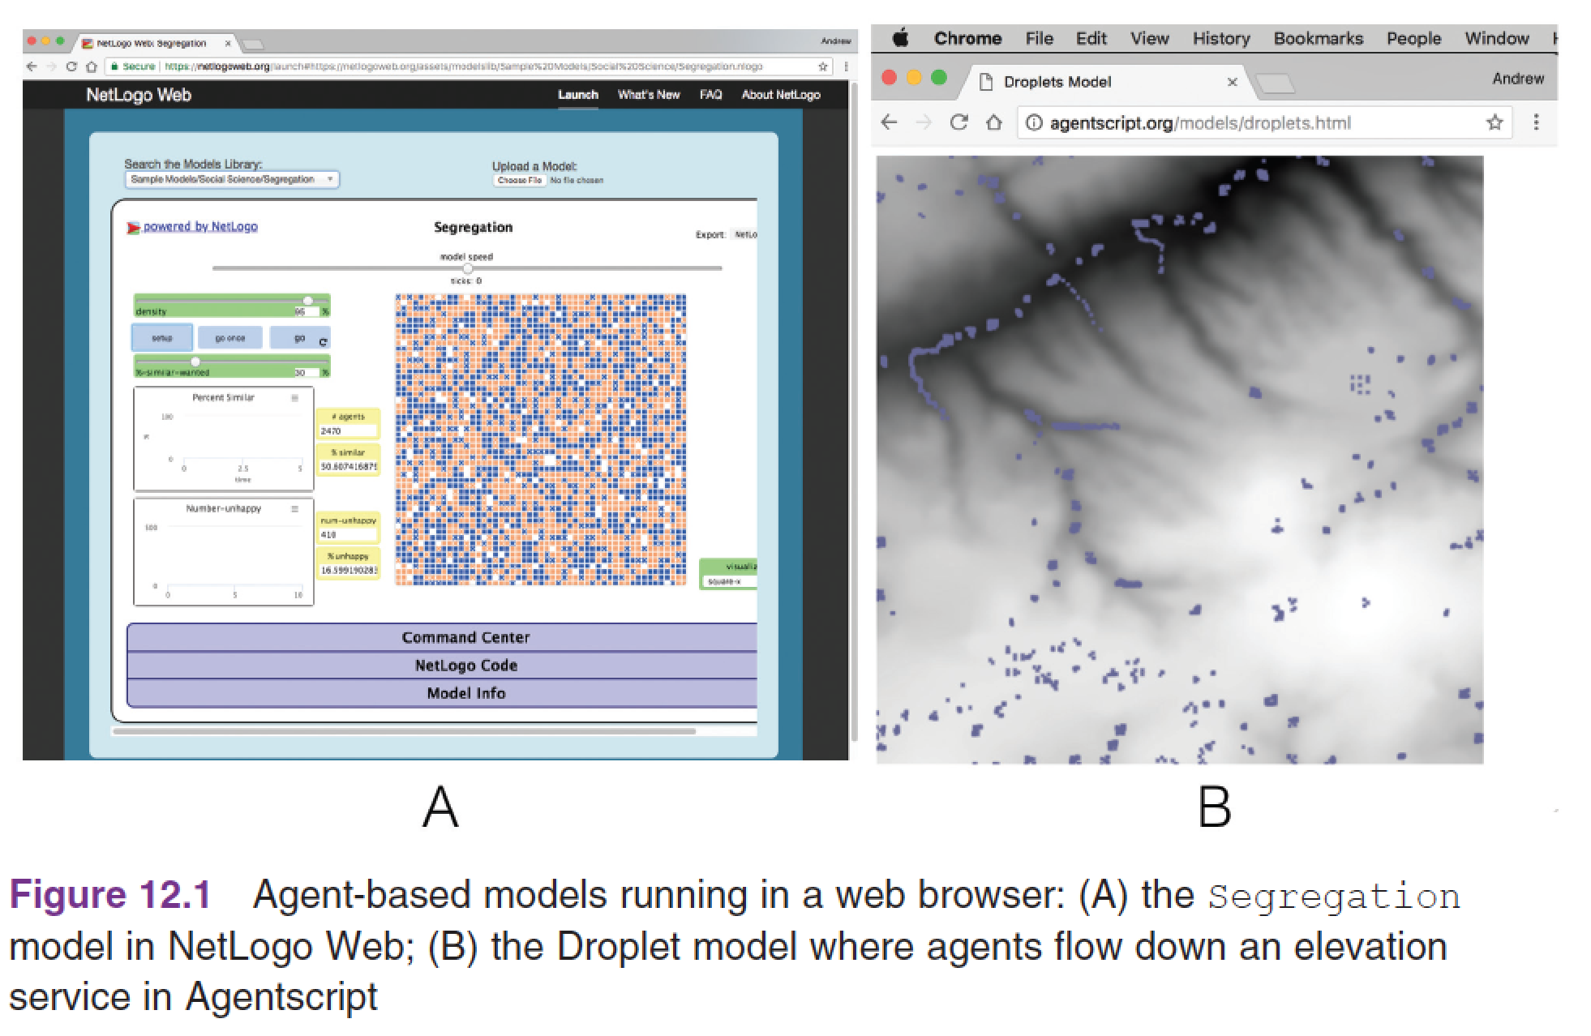
Challenge 8: Sharing and Dissemination of the Model
Taking advantage of the internet to run models in a browser:
https://netlogoweb.org/
http://agentscript.org/
Or utilizing game engines (e.g. Unity) or virtual worlds (e.g. Second Life, OpenSim) for sharing and interacting with models

Slide 14
Challenge 9: Data Challenges
Agent-based models are all about the individual.
Despite the data deluge that we are now experiencing in the wake of the big data movement, there is still a lack of high-quality, linked individual-level data.
Progress is being made:
Researchers are increasingly using established approaches such as microsimulation to generate synthetic populations and the rise in agent-based computational demography
Linking synthetic populations to realistic social networks
If data exists there are also challenges with respect to manipulating and formatting it for use within models.

Slide 15
Looking Ahead

Slide 16
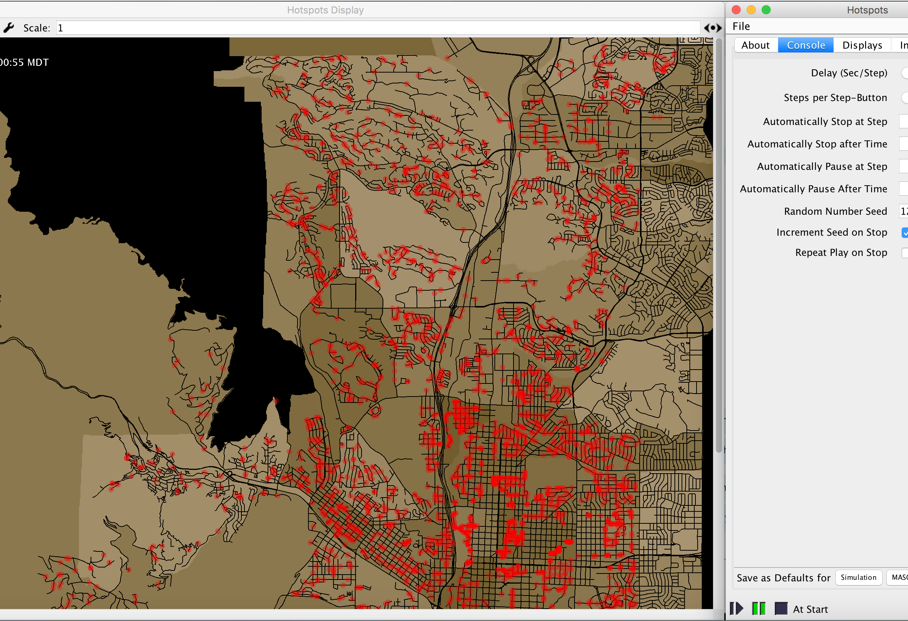
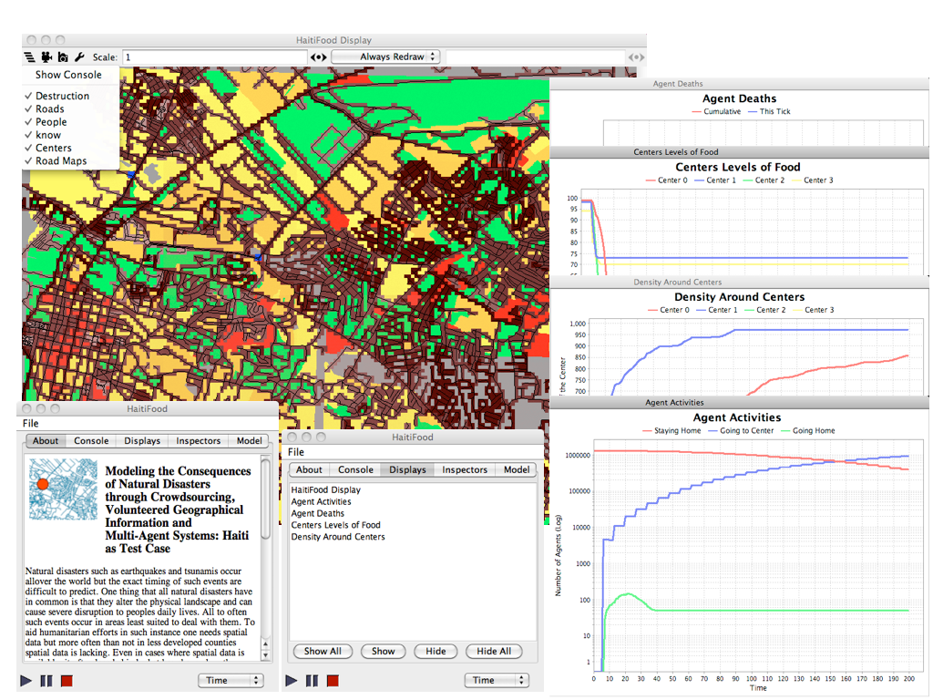
Looking Ahead: Big Data and Agent-based Modeling
New forms of data provide us with new avenues with which to explore how people perceive, use and react to events
We have the potential to incorporate these observations into our models in near real time.
Many of these sources of data (e.g. Social media) allow us to examine the connections between people, organizations and space.
Using Social Media Content To Inform Agent-based Models For Humanitarian Crisis Response
Natural Disasters and Humanitarian Relief
Notes:
Natural Disasters and Humanitarian Relief

Slide 17
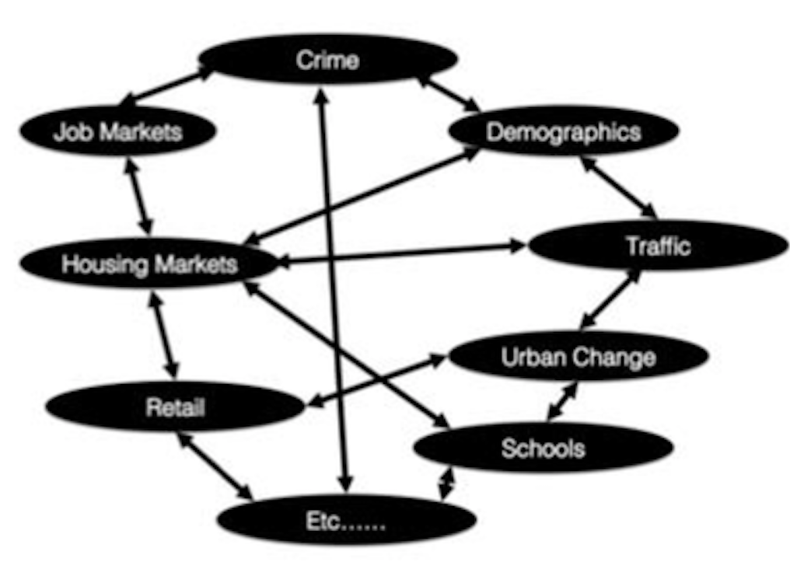
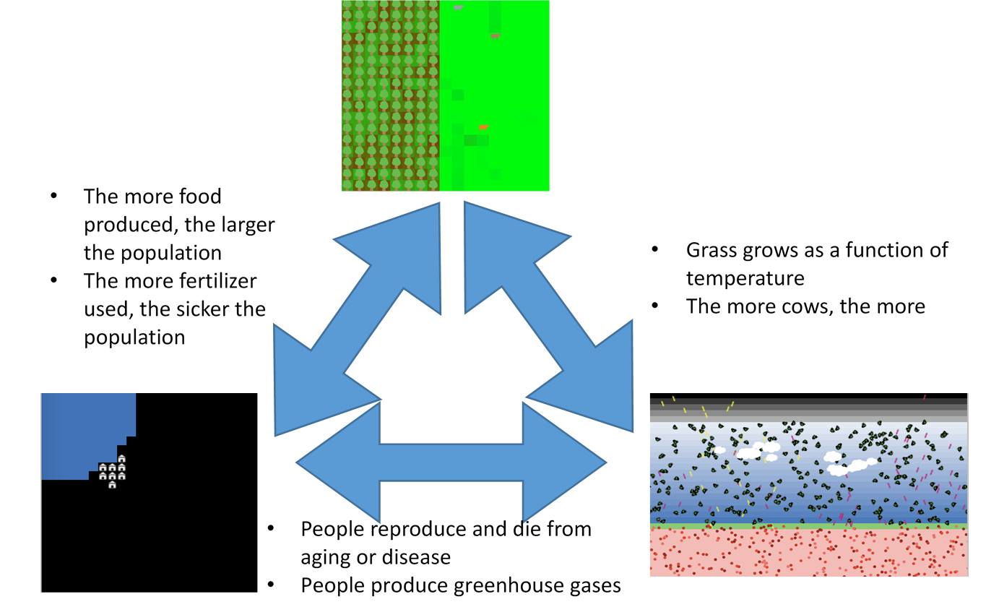
Looking Ahead: Model Integration
While there has been a proliferation of agent-based models, many agent-based models tend to look at only one aspect of a geographical system.
But if we are to address larger societal issues (e.g. climate change, urban change) these individual models will need to be integrated as each just looks at one part of the puzzle.
E.g. NetLogo’s Level Space
Source: http://ccl.northwestern.edu/rp/levelspace/

Slide 18
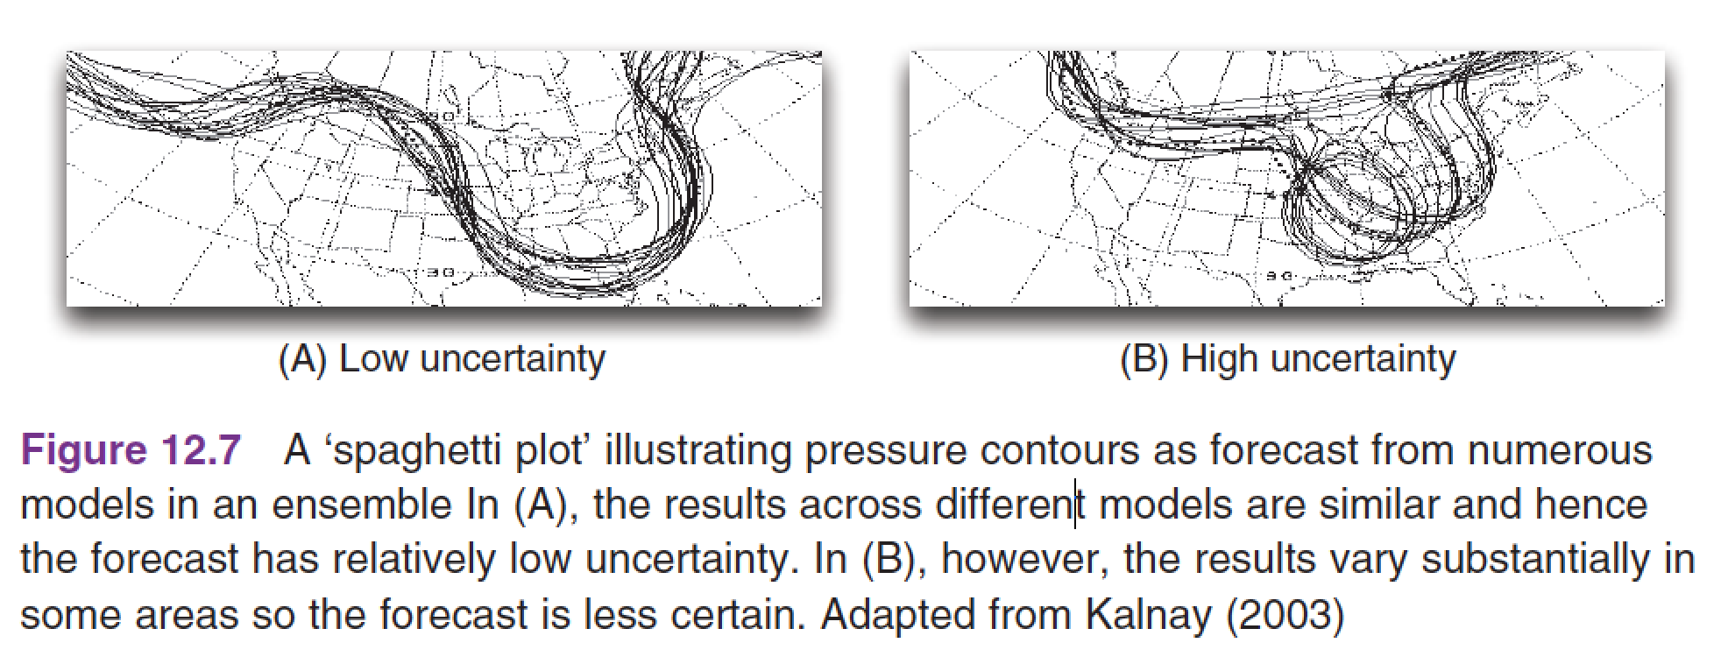
Looking Ahead: Uncertainty and Ensembles
By analyzing the range of outcomes across an ensemble of models, it is possible to begin to better understand how uncertain the outputs are.
A more rigorous treatment of uncertainty also has the potential to improve the trust that others (including policy-makers) can have in the results of an agent-based model

Slide 19
Looking Ahead: Data Assimilation
Agent-based models are often used to simulate the behaviour of complex systems.
These systems often diverge rapidly from some initial starting conditions.
One way to prevent a simulation from diverging from reality would be to occasionally incorporate more up-to-date data and adjust the model accordingly.
The marriage of data assimilation methods and agent-based models could be transformative for the ways that some systems (e.g. ‘smart’ cities) are modelled.

Slide 20
Looking Ahead: Spatially Learning Agents
The way humans recall, describe, and navigate through geographic space is complex.
Many models of human behavior in space tend to assume that agents have ‘perfect’ spatial knowledge and are able to optimize their choices in moving around it.
A promising route forward could be letting the agents learn their environment for themselves (e.g. via reinforcement learning or neural networks)

Slide 21
Discussion
Understanding the complexity of the geographical systems around us is a fundamentally important challenge.
Only through a deeper grasp of how our world works, and an improved ability to predict future changes, we can seek to make improvements or militate against threats.
Agent-based modeling is a highly active and diverse field, enjoying wide success in a variety of contexts.
But we need to addresses the challenges identified earlier to advace the field.

Slide 22
Summary
This chapter has summarized some of the remaining challenges and opportunities for agent-based modelling.
While the discipline has seen considerable progress over the last two decades, greater focus is needed on model replication, transparency and integration.
New forms of data represent a considerable source of promise for agent-based modelling especially in the context of geographical systems.

Slide 23
Further Reading
Readers wishing to know more about running multiple models together in
NetLogo are referred to:
http://ccl.northwestern.edu/rp/levelspace/
For a more detailed discussion of some of the issues brought up in this chapter, see:
Crooks, A.T., Castle, C.J.E. and Batty, M. (2008) Key challenges in agent-based modelling for geo-spatial simulation. Computers, Environment and Urban Systems, 32(6), 417–430.
For more about big data and geographical information or urban applications, see:
Singleton, A.D., Spielman, S. and Folch, D. (2017). Urban Analytics, London: Sage.

Slide 24
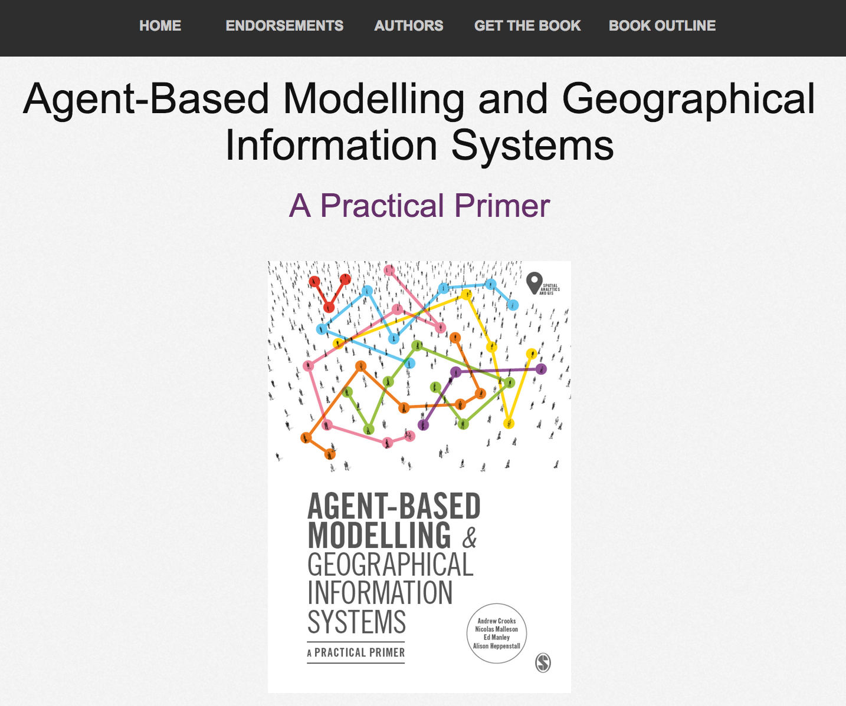
Online Resources
Visit: www.abmgis.org/Chapter12.html for a selection of models to highlight core concepts introduced in this chapter

